Slide 1
Chapter 4 The Processor
4.1 – 4.4: Designing a Single-Cycle Processor

Slide 2
Chapter Topics
Two MIPS implementations
Single-cycle implementation
Pipelined implementation
The implementation includes a subset of the core MIPS instruction set:
Memory reference: lw, sw
Arithmetic/logical: add, sub, and, or, slt
Control transfer: beq, j
Illustrates the key principles to create a datapath and design the control unit.

Slide 3
Designing a Processor: Step-by-Step
Analyze MIPS ISA => major datapath components to execute each class of MIPS instructions.
The meaning of each instruction is given by the register transfers
Datapath must include storage elements for ISA registers
Datapath must support each register transfer
Select datapath components and clocking methodology
Assemble datapath meeting the requirements
Analyze implementation of each instruction
Determine the setting of control signals for register transfer
Assemble the control logic

Slide 4
Review of MIPS Instruction Formats
All instructions are 32-bit wide
Three instruction formats: R-type, I-type, and J-type
Op⁶: 6-bit opcode of the instruction
Rs⁵, Rt⁵, Rd⁵: 5-bit source and destination register numbers
sa⁵: 5-bit shift amount used by shift instructions
funct⁶: 6-bit function field for R-type instructions
immediate¹⁶: 16-bit immediate constant or PC-relative offset
address²⁶: 26-bit target address of the jump instruction
Op⁶
Rs⁵
Rt⁵
Rd⁵
sa⁵
funct⁶
Op⁶
Rs⁵
Rt⁵
immediate¹⁶
Op⁶
address²⁶

Slide 5
MIPS Subset of Instructions
Only a subset of the MIPS instructions is considered
ALU instructions (R-type): add, sub, and, or, xor, slt
Immediate instructions (I-type): addi, slti, andi, ori, xori
Load and Store (I-type): lw, sw
Branch (I-type): beq, bne
Jump (J-type): j
This subset does not include all the integer instructions
But sufficient to illustrate design of datapath and control
Concepts used to implement the MIPS subset are used to construct a broad spectrum of computers
Notes:
In today’s lecture, I will show you how to implement the following subset of MIPS instructions: add, subtract, or immediate, load, store, branch, and the jump instruction.
The Add and Subtract instructions use the R format. The Op together with the Func fields together specified all the different kinds of add and subtract instructions.
Rs and Rt specifies the source registers. And the Rd field specifies the destination register.
The Or immediate instruction uses the I format. It only uses one source register, Rs. The other operand comes from the immediate field. The Rt field is used to specified the destination register. (Note that dest is the Rt field!)
Both the load and store instructions use the I format and both add the Rs and the immediate filed together to from the memory address.
The difference is that the load instruction will load the data from memory into Rt while the store instruction will store the data in Rt into the memory.
The branch on equal instruction also uses the I format. Here Rs and Rt are used to specified the registers we need to compare.
If these two registers are equal, we will branch to a location offset by the immediate field.
Finally, the jump instruction uses the J format and always causes the program to jump to a memory location specified in the address field.
I know I went over this rather quickly and you may have missed something. But don’t worry, this is just an overview. You will keep seeing these (point to the format) all day today.
+3 = 13 min. (X:53)

Slide 6
Details of the MIPS Subset
Instruction | Meaning | Format
add rd, rs, rt | addition | op⁶ = 0 | rs⁵ | rt⁵ | rd⁵ | 0 | 0x20
sub rd, rs, rt | subtraction | op⁶ = 0 | rs⁵ | rt⁵ | rd⁵ | 0 | 0x22
and rd, rs, rt | bitwise and | op⁶ = 0 | rs⁵ | rt⁵ | rd⁵ | 0 | 0x24
or rd, rs, rt | bitwise or | op⁶ = 0 | rs⁵ | rt⁵ | rd⁵ | 0 | 0x25
xor rd, rs, rt | exclusive or | op⁶ = 0 | rs⁵ | rt⁵ | rd⁵ | 0 | 0x26
slt rd, rs, rt | set on less than | op⁶ = 0 | rs⁵ | rt⁵ | rd⁵ | 0 | 0x2a
addi rt, rs, imm¹⁶ | add immediate | 0x08 | rs⁵ | rt⁵ | imm¹⁶
slti rt, rs, imm¹⁶ | slt immediate | 0x0a | rs⁵ | rt⁵ | imm¹⁶
andi rt, rs, imm¹⁶ | and immediate | 0x0c | rs⁵ | rt⁵ | imm¹⁶
ori rt, rs, imm¹⁶ | or immediate | 0x0d | rs⁵ | rt⁵ | imm¹⁶
xori rt, imm¹⁶ | xor immediate | 0x0e | rs⁵ | rt⁵ | imm¹⁶
lw rt, imm¹⁶(rs) | load word | 0x23 | rs⁵ | rt⁵ | imm¹⁶
sw rt, imm¹⁶(rs) | store word | 0x2b | rs⁵ | rt⁵ | imm¹⁶
beq rs, rt, offset¹⁶ | branch if equal | 0x04 | rs⁵ | rt⁵ | offset¹⁶
bne rs, rt, offset¹⁶ | branch not equal | 0x05 | rs⁵ | rt⁵ | offset¹⁶
j address²⁶ | jump | 0x02 | address²⁶

Slide 7
Register Transfer Level (RTL)
RTL is a description of data flow between registers
RTL gives a meaning to the instructions
All instructions are fetched from memory at address PC
Instruction RTL Description
ADD Reg(rd) ← Reg(rs) + Reg(rt); PC ← PC + 4
SUB Reg(rd) ← Reg(rs) – Reg(rt); PC ← PC + 4
ORI Reg(rt) ← Reg(rs) | zero_ext(imm¹⁶); PC ← PC + 4
LW Reg(rt) ← MEM[Reg(rs) + sign_ext(imm¹⁶)]; PC ← PC + 4
SW MEM[Reg(rs) + sign_ext(imm¹⁶)] ← Reg(rt); PC ← PC + 4
BEQ if (Reg(rs) == Reg(rt))
PC ← PC + 4 + 4 × sign_ext(offset¹⁶)
else PC ← PC + 4

Slide 8
Instruction Fetch/Execute
R-type Fetch instruction: Instruction ← MEM[PC]
Fetch operands: data1 ← Reg(rs), data2 ← Reg(rt)
Execute operation: ALU_result ← func(data1, data2)
Write ALU result: Reg(rd) ← ALU_result
Next PC address: PC ← PC + 4
I-type Fetch instruction: Instruction ← MEM[PC]
Fetch operands: data1 ← Reg(rs), data2 ← Extend(imm¹⁶)
Execute operation: ALU_result ← op(data1, data2)
Write ALU result: Reg(rt) ← ALU_result
Next PC address: PC ← PC + 4
BEQ Fetch instruction: Instruction ← MEM[PC]
Fetch operands: data1 ← Reg(rs), data2 ← Reg(rt)
Equality: zero ← subtract(data1, data2)
Branch: if (zero) PC ← PC + 4 + 4×sign_ext(offset¹⁶)
else PC ← PC + 4

Slide 9
Instruction Fetch/Execute – cont’d
LW Fetch instruction: Instruction ← MEM[PC]
Fetch base register: base ← Reg(rs)
Calculate address: address ← base + sign_extend(imm¹⁶)
Read memory: data ← MEM[address]
Write register Rt: Reg(rt) ← data
Next PC address: PC ← PC + 4
SW Fetch instruction: Instruction ← MEM[PC]
Fetch registers: base ← Reg(rs), data ← Reg(rt)
Calculate address: address ← base + sign_extend(imm¹⁶)
Write memory: MEM[address] ← data
Next PC address: PC ← PC + 4
Jump Fetch instruction: Instruction ← MEM[PC]
Target PC address: target ← PC[31:28] || address²⁶ || ‘00’
Jump: PC ← target
concatenation

Slide 10
Instruction Execution
Fetch instruction
PC → Instruction memory
Decode
Decoder ( part of control unit)
Execution
Register numbers → register file, read registers
Depending on instruction class
Use ALU to calculate
Arithmetic result
Memory address for load/store
Branch target address
Access data memory for load/store
PC ← target address or PC + 4
Adder

Slide 11
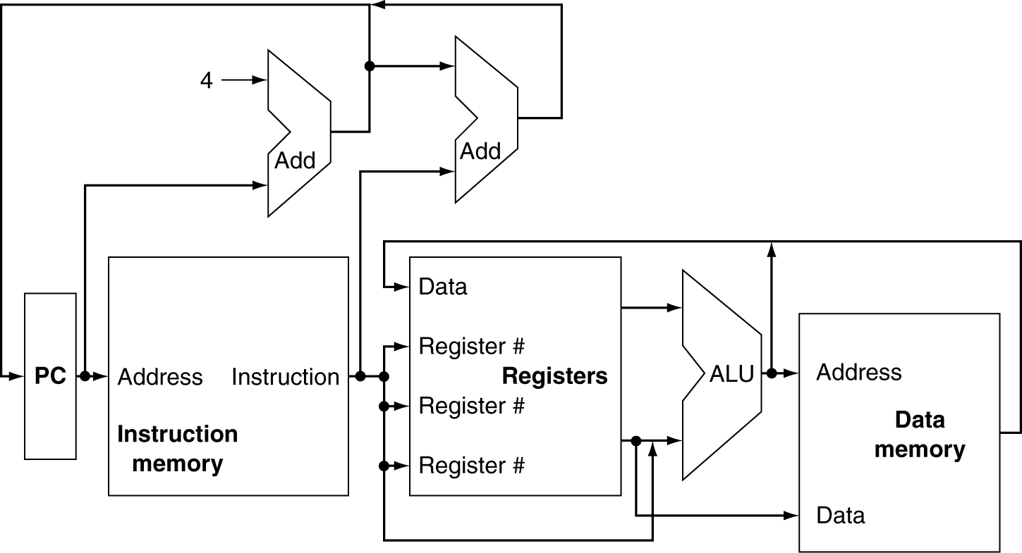
CPU Overview

Slide 12
Multiplexers
Can’t just join wires together
Use multiplexers

Slide 13
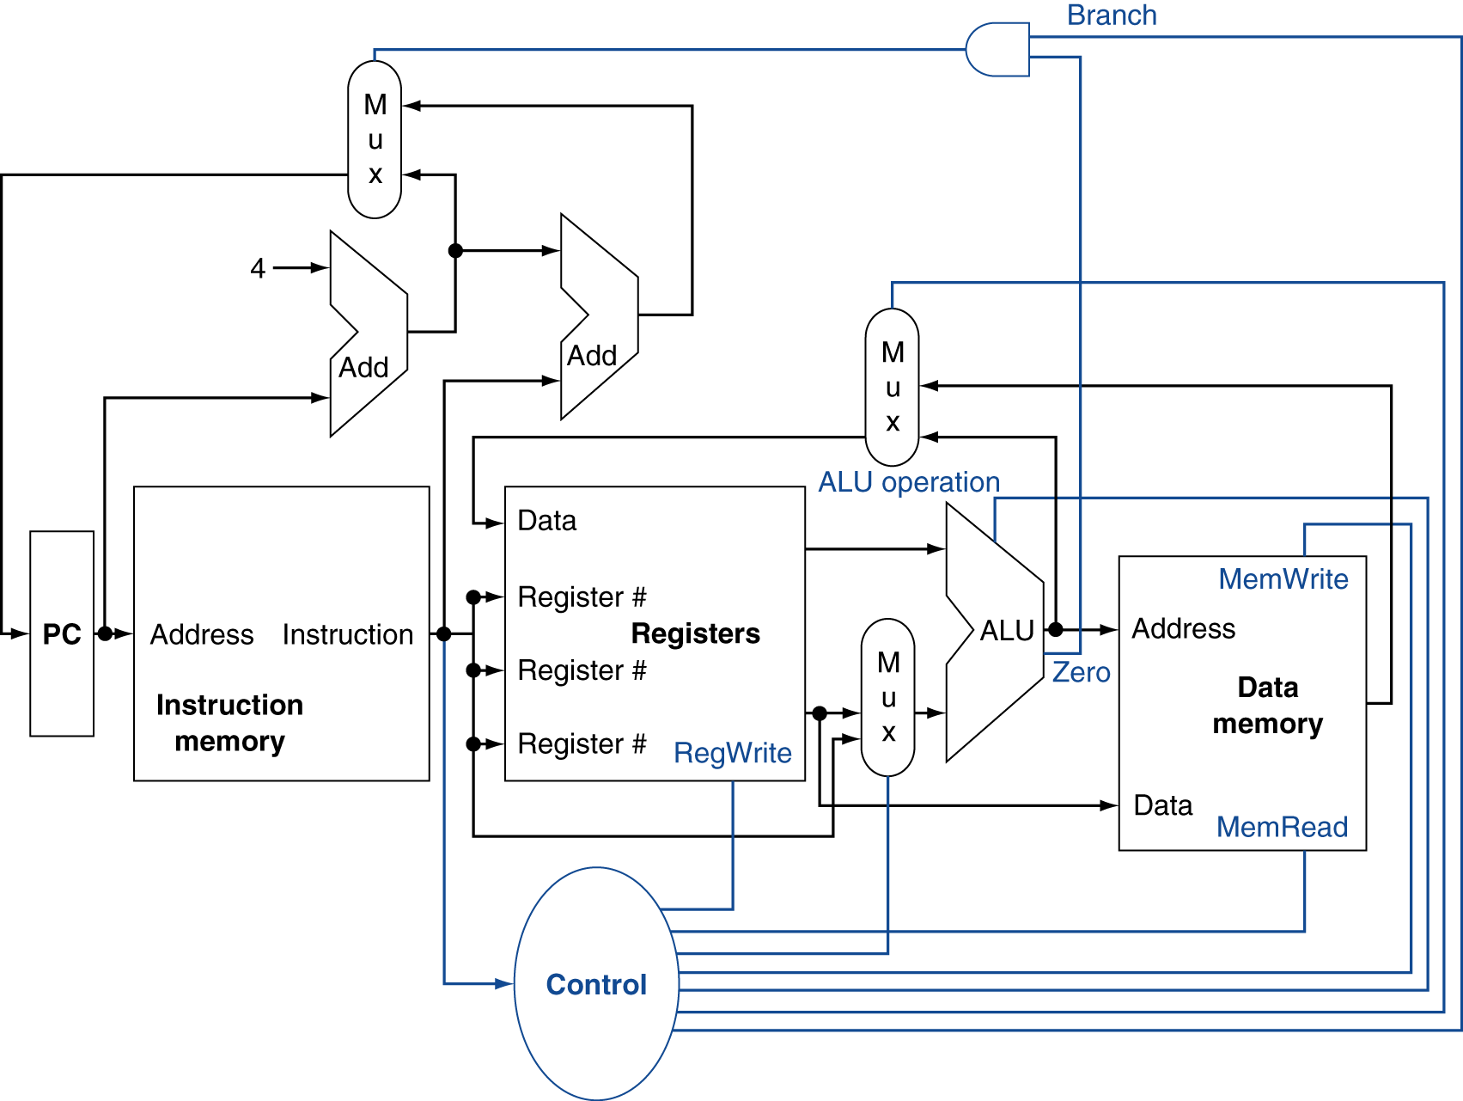
Control

Slide 14
Building a Datapath
§4.3 Building a Datapath
Datapath
Elements that process data and addresses in the CPU
Registers, ALUs, mux’s, memories, …
We will build a MIPS datapath incrementally
Refining the overview design

Slide 15
Requirements of the Instruction Set
§4.3 Building a Datapath
Memory
Instruction memory where instructions are stored
Data memory where data is stored
Registers
31 × 32-bit general purpose registers, R0 is always zero
Read source register Rs
Read source register Rt
Write destination register Rt or Rd
Program counter PC register and Adder to increment PC
Sign and Zero extender for immediate constant
ALU for executing instructions

Slide 16
Components of the Datapath
Combinational Elements
ALU, Adder
Immediate extender
Multiplexers
Storage Elements
Instruction memory
Data memory
PC register
Register file
Clocking methodology
Timing of writes
32
m
u
x
A
L
U
zero
16
0
32
Extend
32
ALU result
ExtOp
1
32
overflow
select
ALUOp
Instruction
32
Data
Memory
32
32
32
Address
32
Address
PC
32
Instruction
Memory
32
Data_out
Data_in
clk
clk
Registers
Mem
Read
Mem
Write
5
RA
BusA
32
5
RB
32
5
BusB
RW
BusW
clk
RegWrite
32

Slide 17
Register Element
Register
Similar to the D-type Flip-Flop
n-bit input and output
Write Enable (WE):
Enable / disable writing of register
Negated (0): Data_Out will not change
Asserted (1): Data_Out will become Data_In after clock edge
Edge triggered Clocking
Register output is modified at clock edge
Data_In
n bits
Write
Enable
Register
WE
Clock
n bits
Data_Out
Notes:
As far as storage elements are concerned, we will need a N-bit register that is similar to the D flip-flop I showed you in class.
The significant difference here is that the register will have a Write Enable input.
That is the content of the register will NOT be updated if Write Enable is not asserted (0).
The content is updated at the clock tick ONLY if the Write Enable signal is asserted (1).
+1 = 31 min. (Y:11)

Slide 18
MIPS Register File
Register File consists of 31 × 32-bit registers
BusA and BusB: 32-bit output busses for reading 2 registers
BusW: 32-bit input bus for writing a register when RegWrite is 1
Two registers read and one written in a cycle
Registers are selected by:
RA selects register to be read on BusA
RB selects register to be read on BusB
RW selects the register to be written
Clock input
The clock input is used ONLY during write operation
During read, register file behaves as a combinational logic block
RA or RB valid => BusA or BusB valid after access time
Register
File
5
RA
BusA
32
5
RB
5
BusB
32
RW
Clock
BusW
RegWrite
32
Notes:
We will also need a register file that consists of 32 32-bit registers with two output busses (busA and busB) and one input bus.
The register specifiers Ra and Rb select the registers to put on busA and busB respectively.
When Write Enable is 1, the register specifier Rw selects the register to be written via busW.
In our simplified version of the register file, the write operation will occurs at the clock tick.
Keep in mind that the clock input is a factor ONLY during the write operation.
During read operation, the register file behaves as a combinational logic block.
That is if you put a valid value on Ra, then bus A will become valid after the register file’s access time.
Similarly if you put a valid value on Rb, bus B will become valid after the register file’s access time. In both cases (Ra and Rb), the clock input is not a factor.
+2 = 33 min. (Y:13)

Slide 19
Details of the Register File
RA
5
RB
5
32
Decoder
"0"
Decoder
"0"
Tri-state
buffers
R1
R0 is not used
WE
32
32
RW
R2
.
.
.
WE
Decoder
5
32
.
.
.
32
32
32
BusW
BusA
R31
WE
RegWrite
32
32
Clock
BusB

Slide 20
Tri-State Buffers
Allow multiple sources to drive a single bus
Two Inputs:
Data_in
Enable (to enable output)
One Output: Data_out
If (Enable) Data_out = Data_in
else Data_out = High Impedance state (output is disconnected)
Tri-state buffers can be
used to build multiplexors
Enable
Data_in
Data_out
Data_0
Output
Data_1
Select

Slide 21
Building a Multifunction ALU
SLL = 00
SRL = 01
SRA = 10
ROR = 11
2
SLT: ALU does a SUB and check the sign and overflow
Shift/Rotate
Operation
Shift Amount
5
Shifter
32
c₀
0
ALU Result
A
32
sign
A
d
d
e
r
≠
1
32
B
32
2
Arithmetic
Operation
ADD = 0
SUB = 1
32
3
overflow
2
zero
Logic Unit
0
ALU
Selection
1
2
Shift = 00
SLT = 01
Arith = 10
Logic = 11
AND = 00
OR = 01
NOR = 10
XOR = 11
Logical
Operation
3
2

Slide 22
Details of the Shifter
Implemented with multiplexers and wiring
Shift Operation can be: SLL, SRL, SRA, or ROR
Input Data is extended to 63 bits according to Shift Op
The 63 bits are shifted right according to S₄S₃S₂S₁S₀
sa
5
SLL
S₄
S₃
S₂
S₁
S₀
16
8
4
2
1
split
0
split
0
split
0
split
0
split
0
32
63
16
31
16
31
47
8
31
8
31
39
4
31
4
31
35
2
31
2
31
33
1
31
1
31
32
Extender
Data
mux
mux
mux
mux
mux
Data_out
31
31
31
31
31
1
1
1
1
1
16
8
4
2
1
2
Shift Right
0 or 4 bits
Shift Right
0 or 2 bits
Shift Right
0 or 1 bit
Shift
op
Shift Right
0 or 16 bits
Shift Right
0 or 8 bits

Slide 23
Details of the Shifter – cont’d
Input data is extended from 32 to 63 bits as follows:
If shift op = SRL then ext_data[62:0] = 0³¹ || data[31:0]
If shift op = SRA then ext_data[62:0] = data[31]³¹ || data[31:0]
If shift op = ROR then ext_data[62:0] = data[30:0] || data[31:0]
If shift op = SLL then ext_data[62:0] = data[31:0] || 0³¹
For SRL, the 32-bit input data is zero-extended to 63 bits
For SRA, the 32-bit input data is sign-extended to 63 bits
For ROR, 31-bit extension = lower 31 bits of data
Then, shift right according to the shift amount
As the extended data is shifted right, the upper bits will be: 0 (SRL), sign-bit (SRA), or lower bits of data (ROR)

Slide 24
Implementing Shift Left Logical
The wiring of the above shifter dictates a right shift
However, we can convert a left shift into a right shift
For SLL, 31 zeros are appended to the right of data
To shift left by 0 is equivalent to shifting right by 31
To shift left by 1 is equivalent to shifting right by 30
To shift left by 31 is equivalent to shifting right by 0
Therefore, for SLL use the 1’s complement of the shift amount
ROL is equivalent to ROR if we use (32 – rotate amount)
ROL by 10 bits is equivalent to ROR by (32–10) = 22 bits
Therefore, software can convert ROL to ROR

Slide 25
Instruction and Data Memories
Instruction memory needs only provide read access
Because datapath does not write instructions
Behaves as combinational logic for read
Address selects Instruction after access time
Data Memory is used for load and store
MemRead: enables output on Data_out
Address selects the word to put on Data_out
MemWrite: enables writing of Data_in
Address selects the memory word to be written
The Clock synchronizes the write operation
Separate instruction and data memories
Later, we will replace them with caches
32
Address
32
Instruction
Instruction
Memory
Data
Memory
32
Address
Data_out
32
32
Data_in
Clock
MemRead
MemWrite
Notes:
The last storage element you will need for the datapath is the idealized memory to store your data and instructions.
This idealized memory block has just one input bus (DataIn) and one output bus (DataOut).
When Write Enable is 0, the address selects the memory word to put on the Data Out bus.
When Write Enable is 1, the address selects the memory word to be written via the DataIn bus at the next clock tick.
Once again, the clock input is a factor ONLY during the write operation.
During read operation, it behaves as a combinational logic block.
That is if you put a valid value on the address lines, the output bus DataOut will become valid after the access time of the memory.
+2 = 35 min. (Y:15)

Slide 26
Clocking Methodology
Clocks are needed in a sequential logic to decide when a state element (register) should be updated
To ensure correctness, a clocking methodology defines when data can be written and read
We assume edge-triggered clocking
All state changes occur on the same clock edge
Data must be valid and stable before arrival of clock edge
Edge-triggered clocking allows a register to be read and written during same clock cycle
Combinational logic
Register 1
Register 2
clock
rising edge
falling edge

Slide 27
Determining the Clock Cycle
With edge-triggered clocking, the clock cycle must be long enough to accommodate the path from one register through the combinational logic to another register
T_{clk-q} : clock to output delay through register
T_{max_comb} : longest delay through combinational logic
T_{s} : setup time that input to a register must be stable before arrival of clock edge
T_{h}: hold time that input to a register must hold after arrival of clock edge
Hold time (T_{h}) is normally satisfied since T_{clk-q} > T_{h}
Combinational logic
Register 1
Register 2
clock
writing edge
T_{clk-q}
T_{max_comb}
T_{s}
T_{h}
T_{cycle} ≥ T_{clk-q} + T_{max_comb} + T_{s}

Slide 28
Clock Skew
Clock skew arises because the clock signal uses different paths with slightly different delays to reach state elements
Clock skew is the difference in absolute time between when two storage elements see a clock edge
With a clock skew, the clock cycle time is increased
T_{cycle} ≥ T_{clk-q} + T_{max_combinational} + T_{setup}+ T_{skew}

Slide 29
Next . . .
Designing a Processor: Step-by-Step
Datapath Components and Clocking
Assembling an Adequate Datapath
Controlling the Execution of Instructions
Main, ALU, and PC Control
Notes:
Here is an outline of today’’s lecture.
Mainly, we will be building a datapath step by step for a subset of the MIPS instruction set.
+1 = 4 min. (X:44)

Slide 30
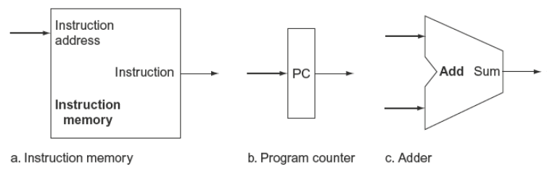
Instruction Fetch
For instruction fetching, we need …
Program Counter (PC) register
Instruction Memory
Adder for incrementing PC

Slide 31
Instruction Fetching Datapath
We can now assemble the datapath from its components
For instruction fetching, we need …
Program Counter (PC) register
Instruction Memory
Adder for incrementing PC
Improved datapath increments upper 30 bits of PC by 1
next PC
The least significant 2 bits of the PC are ‘00’ since PC is a multiple of 4
next PC
4
A
d
d
Improved
Datapath
32
+1
32
30
00
32
00
30
32
32
Instruction
Datapath does not handle branch or jump instructions
32
Instruction
PC
Address
PC
Address
Instruction
Memory
Instruction
Memory
clk
clk

Slide 32
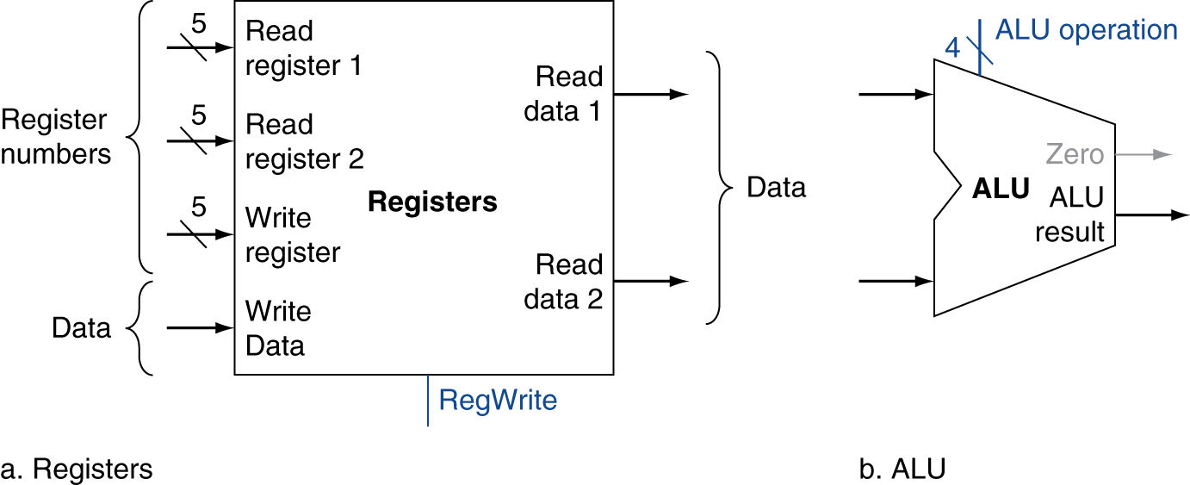
R-Format Instructions
Read two register operands
Perform arithmetic/logical operation
Write register result

Slide 33
Datapath for R-type Instructions
Op⁶
Rs⁵
Rt⁵
Rd⁵
sa⁵
funct⁶
RegWrite
ALU Operation
+1
30
Instruction
Memory
Registers
32
30
32
Rs
5
RA
BusA
A
L
U
00
Instruction
Rt
5
32
32
Address
RB
BusB
PC
Rd
5
RW
32
ALU result
BusW
clk
Rs and Rt fields select two registers to read. Rd field selects register to write
BusA & BusB provide data input to ALU. ALU result is connected to BusW
Same clock updates PC and Rd register
Control signals
ALU Operation is the ALU operation as defined in the funct field for R-type
RegWrite is used to enable the writing of the ALU result

Slide 34
Datapath for I-type ALU Instructions
Op⁶
Rs⁵
Rt⁵
immediate¹⁶
Reg Write
+1
ALU Operation
30
Instruction
Memory
Registers
32
30
32
Rs
5
RA
BusA
A
L
U
00
Instruction
5
32
32
Address
RB
BusB
32
PC
Rt
5
RW
32
ALU result
BusW
clk
ExtOp
Same clock edge updates PC and Rt
Rt selects register to write, not Rd
Imm16
Extender
Second ALU input comes from the extended immediate. RB and BusB are not used
Control signals
ALU Operation is derived from the Op field for I-type instructions
RegWrite is used to enable the writing of the ALU result
ExtOp is used to control the extension of the 16-bit immediate

Slide 35
Combining R-type & I-type Datapaths
RegWr
A mux selects RW as either Rt or Rd
+1
ALUOp
30
Instruction
Memory
Registers
32
30
32
Rs
5
RA
BusA
A
L
U
00
Instruction
Rt
5
32
32
Another mux selects 2nd ALU input as either data on BusB or the extended immediate
32
Address
RB
BusB
0
PC
0
RW
1
Rd
1
BusW
32
clk
RegDst
ExtOp
ALUSrc
Extender
ALU result
Imm16
Control signals
ALUOp is derived from either the Op or the funct field
RegWr enables the writing of the ALU result
ExtOp controls the extension of the 16-bit immediate
RegDst selects the register destination as either Rt or Rd
ALUSrc selects the 2nd ALU source as BusB or extended immediate

Slide 36
Controlling ALU Instructions
RegWr = 1
+1
ALUOp
For R-type ALU instructions, RegDst is ‘1’ to select Rd on RW and ALUSrc is ‘0’ to select BusB as second ALU input. The active part of datapath is shown in green
30
Instruction
Memory
Registers
32
30
32
Rs
5
RA
BusA
A
L
U
00
Instruction
Rt
5
32
32
32
Address
RB
BusB
0
PC
Rd
0
RW
1
1
BusW
clk
RegDst = 1
ExtOp
ALUSrc = 0
Extender
ALU result
Imm16
RegWr = 1
For I-type ALU instructions, RegDst is ‘0’ to select Rt on RW and ALUSrc is ‘1’ to select Extended immediate as second ALU input. The active part of datapath is shown in green
+1
ALUOp
30
Instruction
Memory
Registers
32
30
32
Rs
5
RA
BusA
A
L
U
00
Instruction
Rt
5
32
32
32
Address
RB
BusB
0
PC
Rd
0
RW
1
1
BusW
clk
RegDst = 0
ExtOp
ALUSrc = 1
Extender
32
ALU result
Imm16

Slide 37
Details of the Extender
Two types of extensions
Zero-extension for unsigned constants
Sign-extension for signed constants
Control signal ExtOp indicates type of extension
Extender Implementation: wiring and one AND gate
ExtOp = 0 ⇒ Upper16 = 0
Upper
16 bits
.
.
.
ExtOp = 1 ⇒
Upper16 = sign bit
ExtOp
Imm16
Lower
16 bits
.
.
.

Slide 38
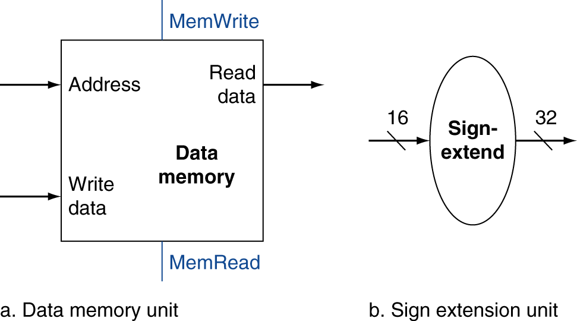
Load/Store Instructions
Read register operands
Calculate address using 16-bit offset
Use ALU, but sign-extend offset
Load: Read memory and update register
Store: Write register value to memory

Slide 39
Load and Store Word
Load Word Instruction (Word = 4 bytes in MIPS)
lw Rt, imm¹⁶(Rs) # Rt ⬅ MEMORY[Rs+imm¹⁶]
Store Word Instruction
sw Rt, imm¹⁶(Rs) # Rt ➔ MEMORY[Rs+imm¹⁶]
Base or Displacement addressing is used
Memory Address = Rs (base) + Immediate¹⁶ (displacement)
Immediate¹⁶ is sign-extended to have a signed displacement
Base or Displacement Addressing
Op⁶
Rs⁵
Rt⁵
immediate¹⁶
+
Memory Word
Base address

Slide 40
Adding Data Memory to Datapath
A data memory is added for load and store instructions
Op⁶
Rs⁵
Rt⁵
immediate¹⁶
ExtOp
ALUOp
MemRd
MemWr
Imm16
Extender
32
ALUSrc
WBdata
+1
ALU result
30
Instruction
Memory
Rs
5
Registers
32
Data
Memory
30
RA
BusA
A
L
U
00
Instruction
32
32
0
32
32
Rt
5
RB
BusB
Address
32
PC
Address
0
0
Data_out
1
Rd
1
RW
BusW
Data_in
1
RegDst
32
Reg
Wr
clk
RegWr
+1
ALUOp
30
Instruction
Memory
Registers
32
30
32
Rs
5
RA
BusA
A
L
U
00
Instruction
Rt
5
32
32
32
Address
RB
BusB
0
PC
0
RW
1
Rd
1
BusW
32
clk
RegDst
ExtOp
ALUSrc
Extender
ALU result
Imm16

Slide 41
Adding Data Memory to Datapath
A data memory is added for load and store instructions
ExtOp
ALUOp
MemRead
MemWrite
Imm16
E
32
ALUSrc
MemtoReg
+1
ALU result
30
Instruction
Memory
Rs
5
Registers
32
Data
Memory
30
RA
BusA
A
L
U
00
Instruction
32
32
0
32
32
Rt
5
RB
BusB
Address
32
PC
Address
0
0
Data_out
1
Rd
1
RW
BusW
Data_in
1
RegDst
RegWrite
32
clk
ALU calculates data memory address
A 3rd mux selects data on BusW as either ALU result or memory data_out
Additional Control signals
MemRd for load instructions
MemWr for store instructions
MemtoReg selects data on BusW as ALU result or Memory Data_out
BusB is connected to Data_in of Data Memory for store instructions

Slide 42
Controlling the Execution of Load
ExtOp = 1
ALUOp
= ADD
MemRd
= 1
MemWr
= 0
Imm16
32
ALUSrc
= 1
E
ALU result
MemtoReg
= 1
+1
30
Instruction
Memory
Rs
5
Registers
32
Data
Memory
30
RA
BusA
A
L
U
00
Instruction
32
32
0
32
32
Rt
5
RB
BusB
Address
32
PC
Address
0
0
Data_out
1
Rd
1
RW
BusW
Data_in
1
RegDst
= 0
32
clk
RegWrite
= 1
RegDst = ‘0’ selects Rt as destination register
RegWrite = ‘1’ to enable writing of register file
ExtOp = 1 to sign-extend Immmediate16 to 32 bits
ALUSrc = ‘1’ selects extended immediate as second ALU input
ALUOp = ‘ADD’ to calculate data memory address as Reg(Rs) + sign-extend(Imm16)
MemRd = ‘1’ to read data memory
MemtoReg = ‘1’ places the data read from memory on BusW
Clock edge updates PC and Register Rt

Slide 43
Controlling the Execution of Store
ExtOp = 1
ALUOp
= ADD
MemRd
= 0
MemWr
= 1
Imm16
32
ALUSrc
= 1
E
ALU result
MemtoReg
= X
+1
30
Instruction
Memory
Rs
5
Registers
32
Data
Memory
30
RA
BusA
A
L
U
00
Instruction
32
32
0
32
32
Rt
5
RB
BusB
Address
32
PC
Address
0
0
Data_out
1
Rd
1
RW
BusW
Data_in
1
RegDst
= X
32
clk
RegWrite
= 0
RegDst = ‘X’ because no register is written
RegWrite = ‘0’ to disable writing of register file
ExtOp = 1 to sign-extend Immmediate16 to 32 bits
ALUSrc = ‘1’ selects extended immediate as second ALU input
ALUOp = ‘ADD’ to calculate data memory address as Reg(Rs) + sign-extend(Imm16)
MemWr = ‘1’ to write data memory
MemtoReg = ‘X’ because don’t care what data is put on BusW
Clock edge updates PC and Data Memory

Slide 44
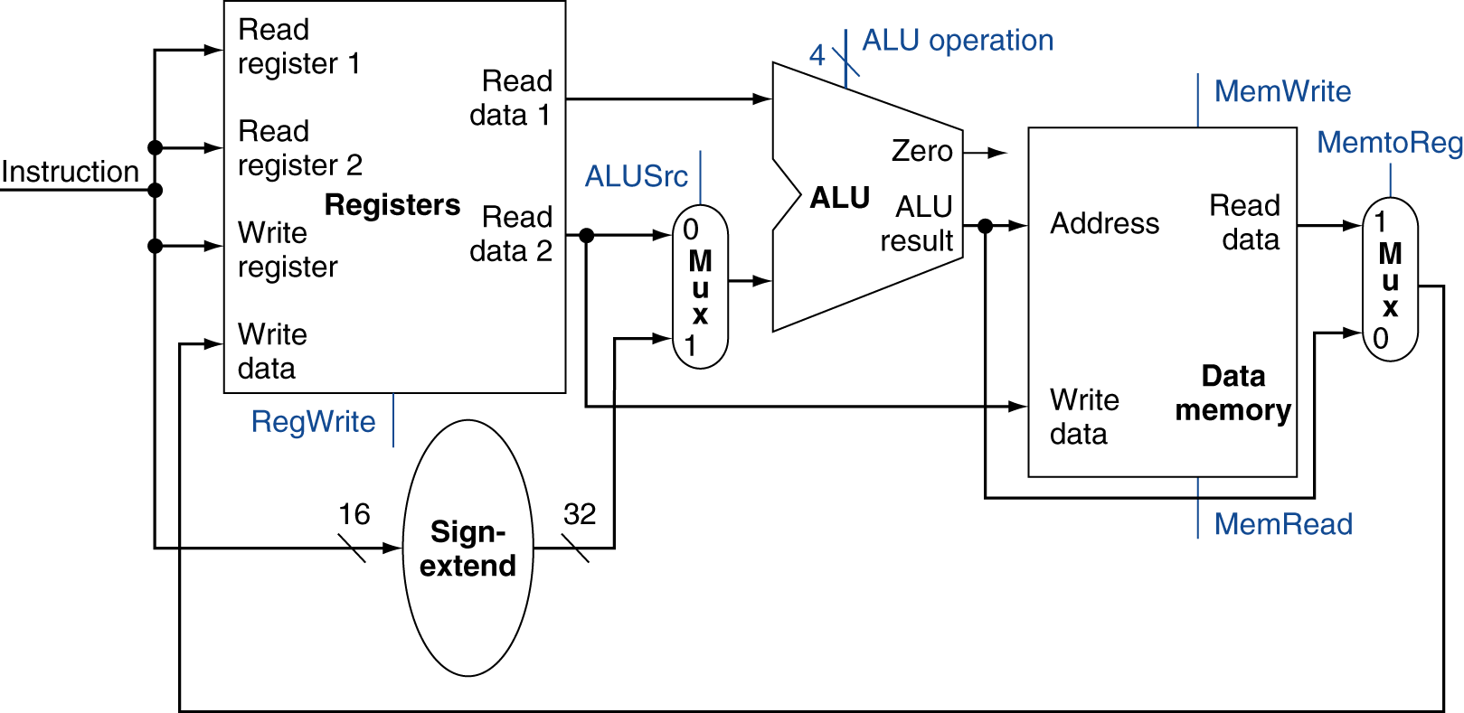
R-Type/I-Type/Load/Store Datapath

Slide 45
Branch Instructions
beq Rs,Rt,label branch to label if (Rs == Rt)
bne Rs,Rt,label branch to label if (Rs != Rt)
Read register operands
Compare operands
Use ALU, subtract and check Zero output
Calculate target address
Sign-extend displacement
Shift left 2 places (word displacement)
Add to PC + 4
Already calculated by instruction fetch

Slide 46
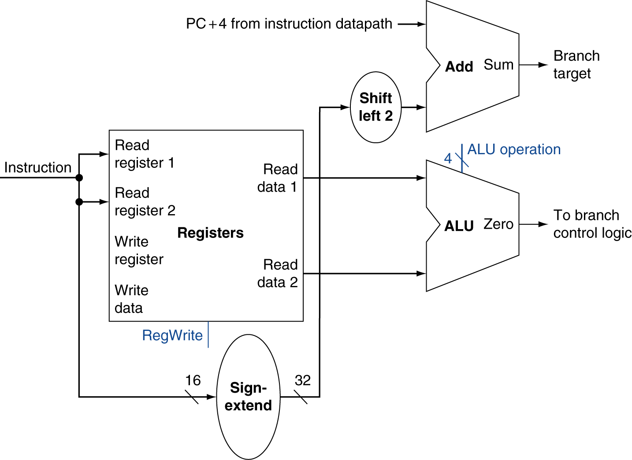
Branch Instructions
Just re-routes wires
Sign-bit wire replicated

Slide 47
Implementing Jumps
Jump
2
address
31:26
25:0
Jump uses word address
Update PC with concatenation of
Top 4 bits of old PC
26-bit jump address
00
Need an extra control signal decoded from opcode

Slide 48
Adding Jump and Branch to Datapath
PCSrc
Adding a mux at the PC input
2
Branch Target Address
1
Jump Target = PC[31:28] ‖ Imm26
New adder for computing branch target address
0
ExtOp
Next PC Address
+
+1
Imm16
E
Zero
ALU result
Instruction
Memory
Rs
Registers
Data
Memory
00
RA
BusA
A
L
U
Address
Rt
RB
Address
0
PC
1
Data_out
1
Instruction
0
BusB
0
Rd
1
RW
Data_in
BusW
clk
Op
Reg
Dst
RegWr
ALU
Src
ALU
Op
Mem
Rd
Mem
Wr
WB
data
Additional Control Signals
PCSrc for PC control: 1 for a jump and 2 for a taken branch
Zero flag for branch control: whether branch is taken or not

Slide 49
Controlling the Execution of a Jump
PCSrc = 1
2
Branch Target Address
If (Opcode == J) then
PCSrc = 1 (Jump Target)
1
Jump Target = PC[31:28] ‖ Imm26
0
ExtOp = X
Next PC Address
+
+1
Imm16
E
Zero = X
ALU result
Instruction
Memory
Rs
Registers
Data
Memory
00
RA
BusA
A
L
U
Address
Rt
RB
Address
0
PC
1
Data_out
1
Instruction
0
BusB
0
Rd
1
RW
Data_in
BusW
clk
Op
= J
Reg
Dst
= X
Reg
Wr
= 0
ALU
Src
= X
ALU
Op
= X
Mem
Rd
= 0
Mem
Wr
= 0
WB
data
= X
MemRd = MemWr = RegWr = 0, Don't care about other control signals
Clock edge updates PC register only

Slide 50
Controlling the Execution of a Branch
PCSrc = 2
Branch Target Address
If (Opcode == BEQ && Zero == 1) then PCSrc = 2 (Branch Target)
else PCSrc = 0 (Next PC)
2
1
Jump Target = PC[31:28] ‖ Imm26
0
ExtOp = 1
Next PC Address
+
+1
Imm16
E
Zero = 1
ALU result
Instruction
Memory
Rs
Registers
Data
Memory
00
RA
BusA
A
L
U
Address
Rt
RB
Address
0
PC
1
Data_out
1
Instruction
0
BusB
0
Rd
1
RW
Data_in
BusW
clk
Op
BEQ
Reg
Dst
= X
Reg
Wr
= 0
ALU
Src
= 0
ALU
Op
= SUB
Mem
Rd
= 0
Mem
Wr
= 0
WB
data
= X
ALUSrc = 0, ALUOp = SUB, ExtOp = 1, MemRd = MemWr = RegWr = 0
Clock edge updates PC register only

Slide 51
Main, ALU, and PC Control
Instruction
Memory
Zero
0
Datapath
A
L
U
§4.4 A Simple Implementation Scheme
1
PC
Address
Instruction
32
2
WBdata
MemWr
RegDst
RegWr
ExtOp
ALUSrc
MemRd
PCSrc
Op⁶
funct⁶
ALUOp
PC
Control
Zero
Main
Control
ALU
Control
Op⁶
PC Control Input
6-bit opcode
ALU zero flag
PC Control Output
PCSrc signal
Main Control Input
6-bit opcode field
Main Control Output
Main control signals
ALU Control Input
6-bit opcode field
6-bit function field
ALU Control Output
ALUOp signal for ALU

Slide 52
Single-Cycle Datapath + Control
Branch Target Address
Jump Target = PC[31:28] ‖ Imm26
ExtOp
Next PC Address
+
+1
Imm16
Ext
ALU result
Zero
Instruction
Memory
Rs
Registers
Data
Memory
00
RA
BusA
A
L
U
0
Address
1
Address
Rt
RB
0
PC
1
Data_out
1
2
Instruction
0
BusB
0
Rd
1
RW
Data_in
BusW
PCSrc
clk
func
ALUop
MemRd
MemtoReg
PC
Ctrl
RegDst
RegWr
ALU
Ctrl
Op
MemWr
ExtOp
ALUSrc
Main
Control
Zero

Slide 53
The Main Control Unit
Control signals derived from instruction
R-type
0
rs
rt
rd
shamt
funct
31:26
25:21
20:16
15:11
10:6
5:0
Load/ Store
35 or 43
rs
rt
address
31:26
25:21
20:16
15:0
Branch
4
rs
rt
address
31:26
25:21
20:16
15:0
opcode
always read
read, except for load
write for R-type and load
sign-extend and add

Slide 54
Main Control Signals
Signal | Effect when ‘0’ | Effect when ‘1’
RegDst | Destination register = Rt | Destination register = Rd
RegWr | No register is written | Destination register (Rt or Rd) is written with the data on BusW
ExtOp | 16-bit immediate is zero-extended | 16-bit immediate is sign-extended
ALUSrc | Second ALU operand is the value of register Rt that appears on BusB | Second ALU operand is the value of the extended 16-bit immediate
MemRd | Data memory is NOT read | Data memory is read Data_out ← Memory[address]
MemWr | Data Memory is NOT written | Data memory is written Memory[address] ← Data_in
MemtoReg | BusW = ALU result | BusW = Data_out from Memory

Slide 55
Main Control Truth Table
Op | RegDst | RegWr | ExtOp | ALUSrc | MemRd | MemWr | MemtoReg
R-type | 1 = Rd | 1 | X | 0 = BusB | 0 | 0 | 0 = ALU
ADDI | 0 = Rt | 1 | 1 = sign | 1 = Imm | 0 | 0 | 0 = ALU
SLTI | 0 = Rt | 1 | 1 = sign | 1 = Imm | 0 | 0 | 0 = ALU
ANDI | 0 = Rt | 1 | 0 = zero | 1 = Imm | 0 | 0 | 0 = ALU
ORI | 0 = Rt | 1 | 0 = zero | 1 = Imm | 0 | 0 | 0 = ALU
XORI | 0 = Rt | 1 | 0 = zero | 1 = Imm | 0 | 0 | 0 = ALU
LW | 0 = Rt | 1 | 1 = sign | 1 = Imm | 1 | 0 | 1 = Mem
SW | X | 0 | 1 = sign | 1 = Imm | 0 | 1 | X
BEQ | X | 0 | 1 = sign | 0 = BusB | 0 | 0 | X
BNE | X | 0 | 1 = sign | 0 = BusB | 0 | 0 | X
J | X | 0 | X | X | 0 | 0 | X
X is a don’t care (can be 0 or 1), used to minimize logic

Slide 56
Logic Equations for Main Control Signals
RegDst = R-type
RegWrite = (SW + BEQ + BNE + J)
ExtOp = (ANDI + ORI + XORI)
ALUSrc = (R-type + BEQ + BNE)
MemRd = LW
MemWr = SW
MemtoReg = LW
Op⁶
Decoder
R-type
SLTI
BEQ
ADDI
ANDI
ORI
XORI
LW
SW
BNE
J
Logic Equations
RegDst
RegWr
ExtOp
ALUSrc
MemRd
WBdata
MemWr

Slide 57
ALU Control Truth Table
Op | funct | ALU function | 4-bit Coding
R-type | AND | AND | 0001
R-type | OR | OR | 0010
R-type | XOR | XOR | 0011
R-type | ADD | ADD | 0100
R-type | SUB | SUB | 0101
R-type | SLT | SLT | 0110
ADDI | X | ADD | 0100
SLTI | X | SLT | 0110
ANDI | X | AND | 0001
ORI | X | OR | 0010
XORI | X | XOR | 0011
LW | X | ADD | 0100
SW | X | ADD | 0100
BEQ | X | SUB | 0101
BNE | X | SUB | 0101
J | X | X | X
The 4-bit Coding defines the binary ALU operations.
Logic equations are derived for the 4-bit coding.

Slide 58
ALU Control
opcode | ALUOp | Operation | funct | ALU function | ALU control
R-type | 000 | AND | 100100 | and | 0001
 |  | OR | 100101 | or | 0010
 |  | XOR | 100110 | xor | 0011
 |  | add | 100000 | add | 0100
 |  | subtract | 100010 | subtract | 0101
 |  | set-on-less-than | 101010 | set-on-less-than | 0110
ADDI | 100 | ADD Immediate | XXXXXX | add | 0100
SLTI | 101 | set-on-less-than immediate | XXXXXX | set-on-less-than | 0110
ANDI | 001 | AND immediate | XXXXXX | and | 0001
ORI | 010 | OR immediate | XXXXXX | or | 0010
XORI | 011 | XOR immediate | XXXXXX | xor | 0011
LW | 100 | load word | XXXXXX | add | 0100
SW | 100 | store word | XXXXXX | add | 0100
BEQ | 101 | branch equal | XXXXXX | subtract | 0101
BNE | 101 | branch not equal | XXXXXX | subtract | 0101

Slide 59
PC Control Truth Table
Op | Zero flag | PCSrc
R-type | X | 0 = Increment PC
J | X | 1 = Jump Target Address
BEQ | 0 | 0 = Increment PC
BEQ | 1 | 2 = Branch Target Address
BNE | 0 | 2 = Branch Target Address
BNE | 1 | 0 = Increment PC
Other than Jump or Branch | X | 0 = Increment PC
The ALU Zero flag is used by BEQ and BNE instructions

Slide 60
PC Control Logic
The PC control logic can be described as follows:
if (Op == J) PCSrc = 1;
else if ((Op == BEQ && Zero == 1) ||
(Op == BNE && Zero == 0)) PCSrc = 2;
else PCSrc = 0;
Op
Decoder
Branch = (BEQ . Zero) + (BNE . Zero)
Branch = 1, Jump = 0 ➔ PCSrc = 2
Branch = 0, Jump = 1 ➔ PCSrc = 1
Branch = 0, Jump = 0 ➔ PCSrc = 0
BEQ
BNE
J
Zero
Branch
Jump

Slide 61
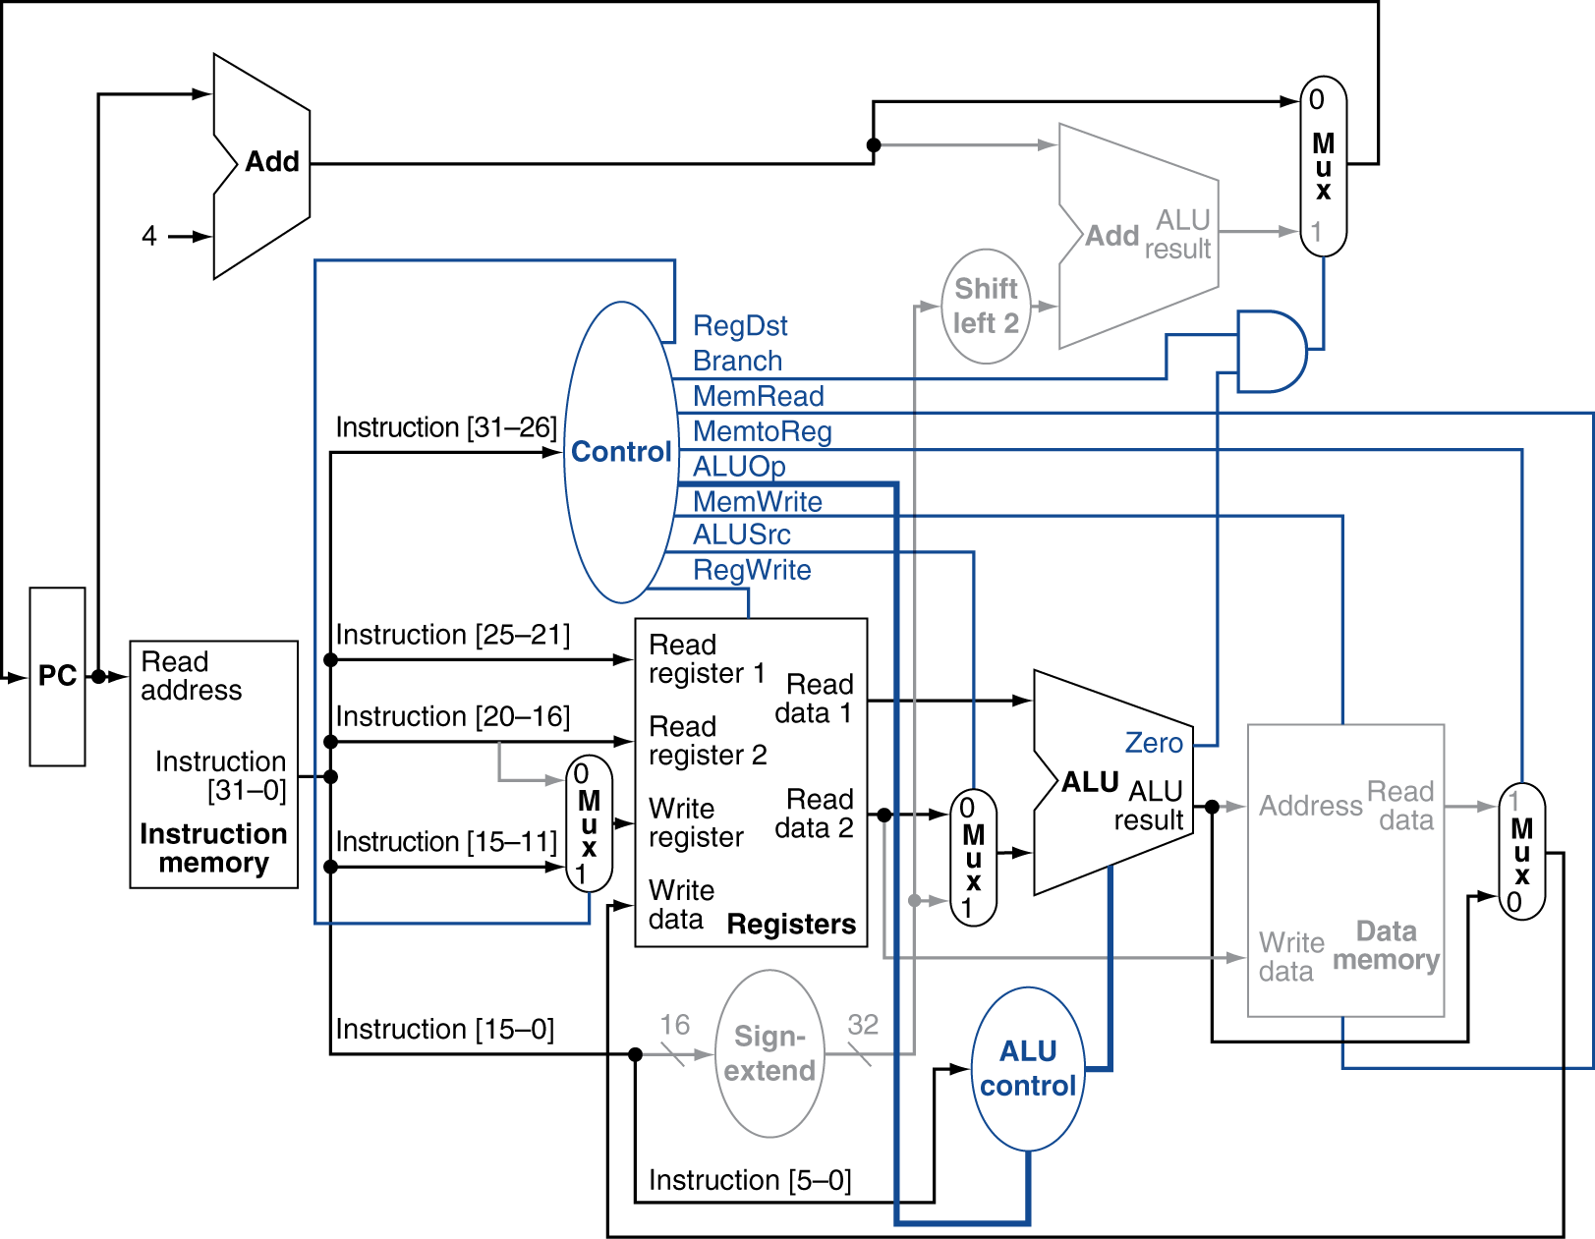
R-Type Instruction

Slide 62
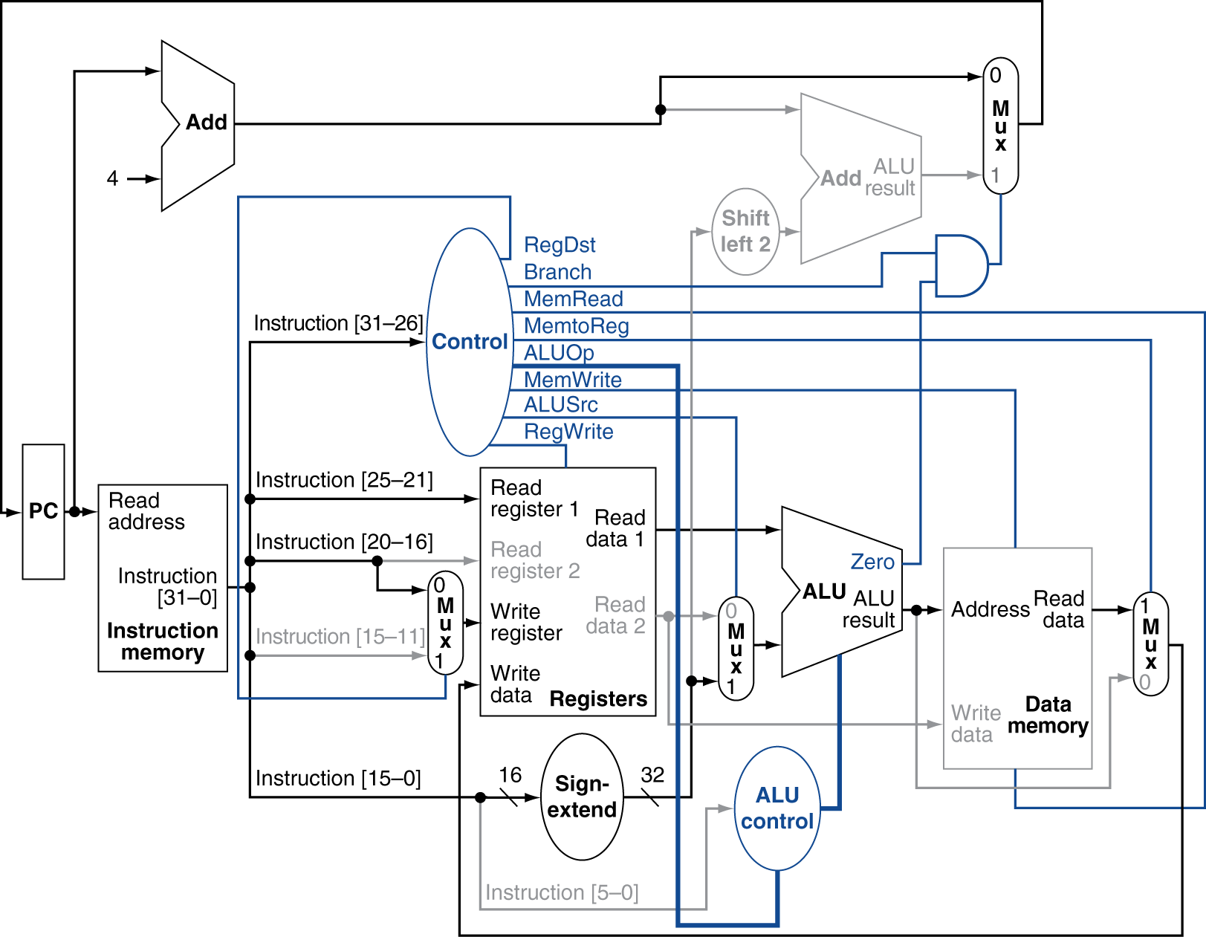
Load Instruction

Slide 63
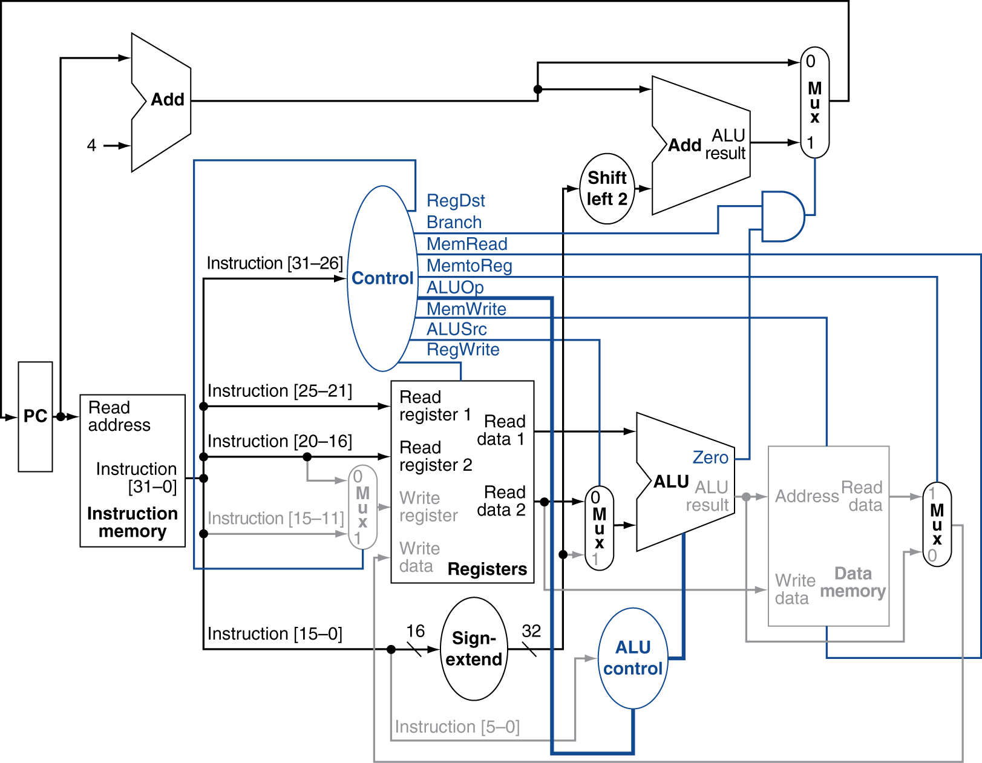
Branch-on-Equal Instruction

Slide 64
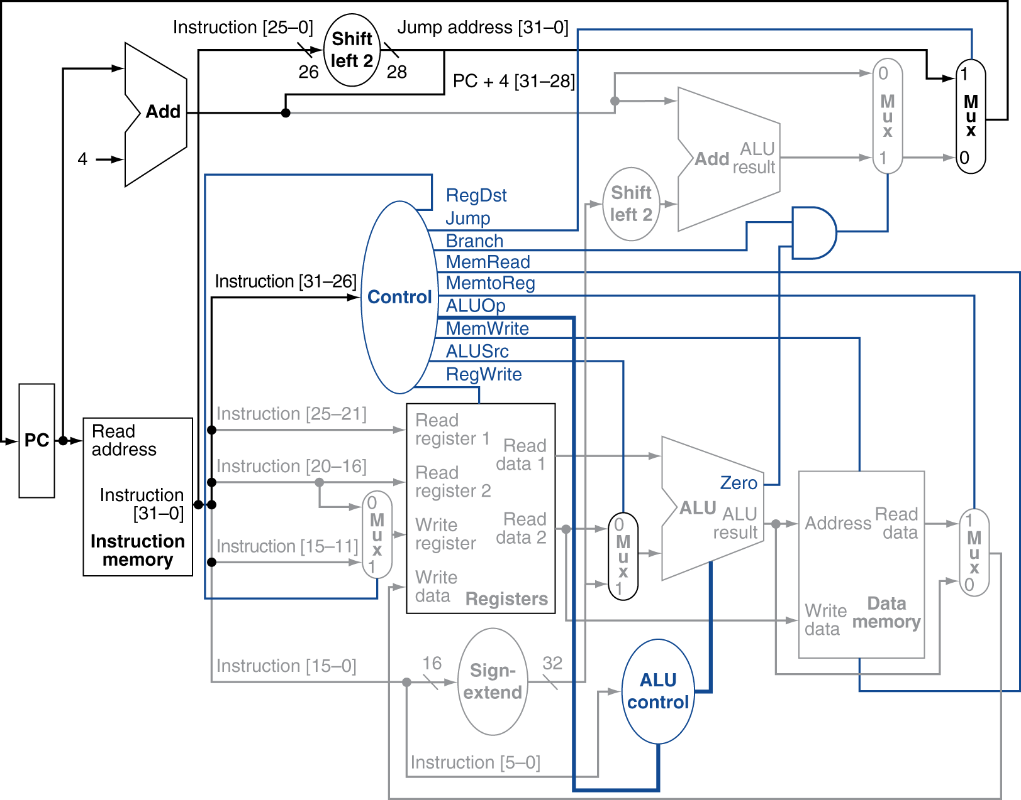
Datapath With Jumps Added

